Slide 1
Statistical Analysis of Sub-Poisson Light
John Hummel

Slide 2
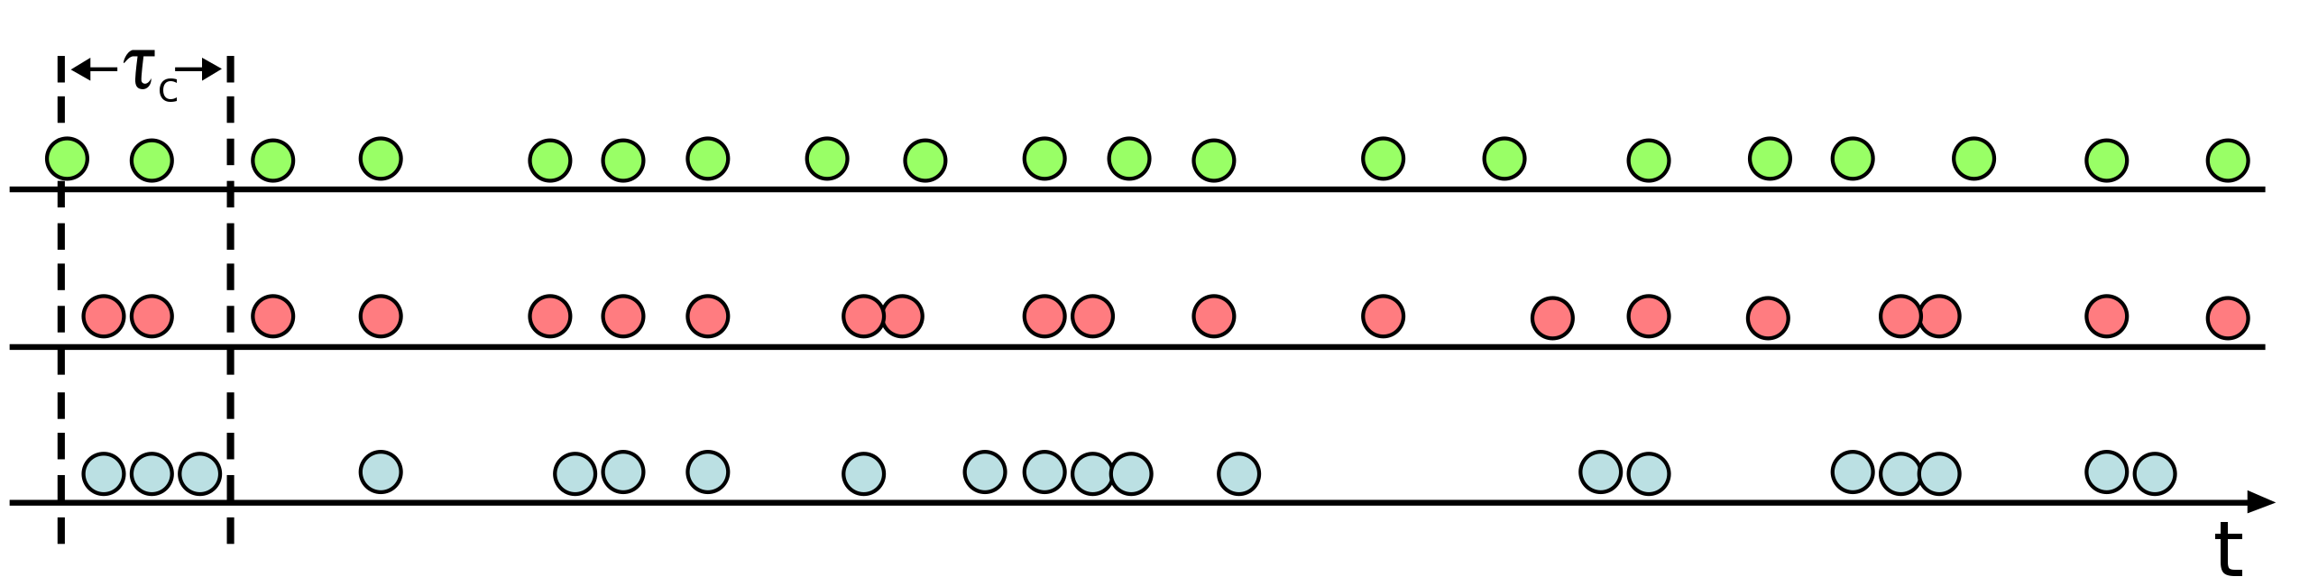

Anti bunch light
Anti bunch = sub poisson
$Δn^{2}<⟨n⟩$is the condition for sub-poisson light
Anti-bunched
Non-bunched
Bunched

Slide 3
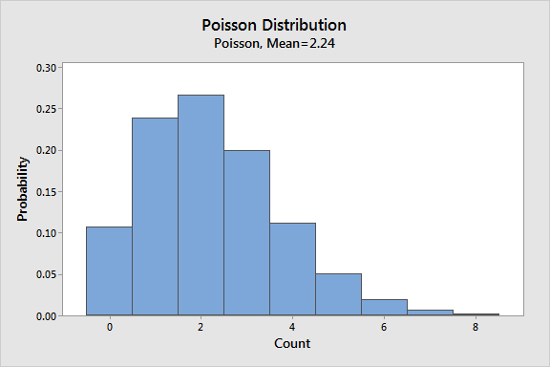
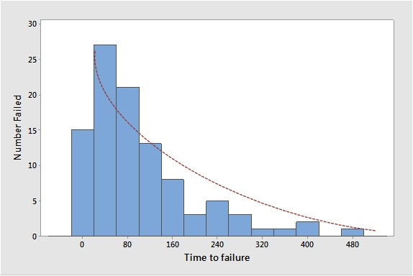


Poisson and Expoenential Distribution
Poisson: events given a certain time interval
https://statisticsbyjim.com/probability/poisson-distribution/
Exponential: time between events
$$f\left(x\right)=λe^{−λx}$$
$$f\left(x\right)=\frac{λ^{x}e^{−x}}{x!}$$

Slide 4
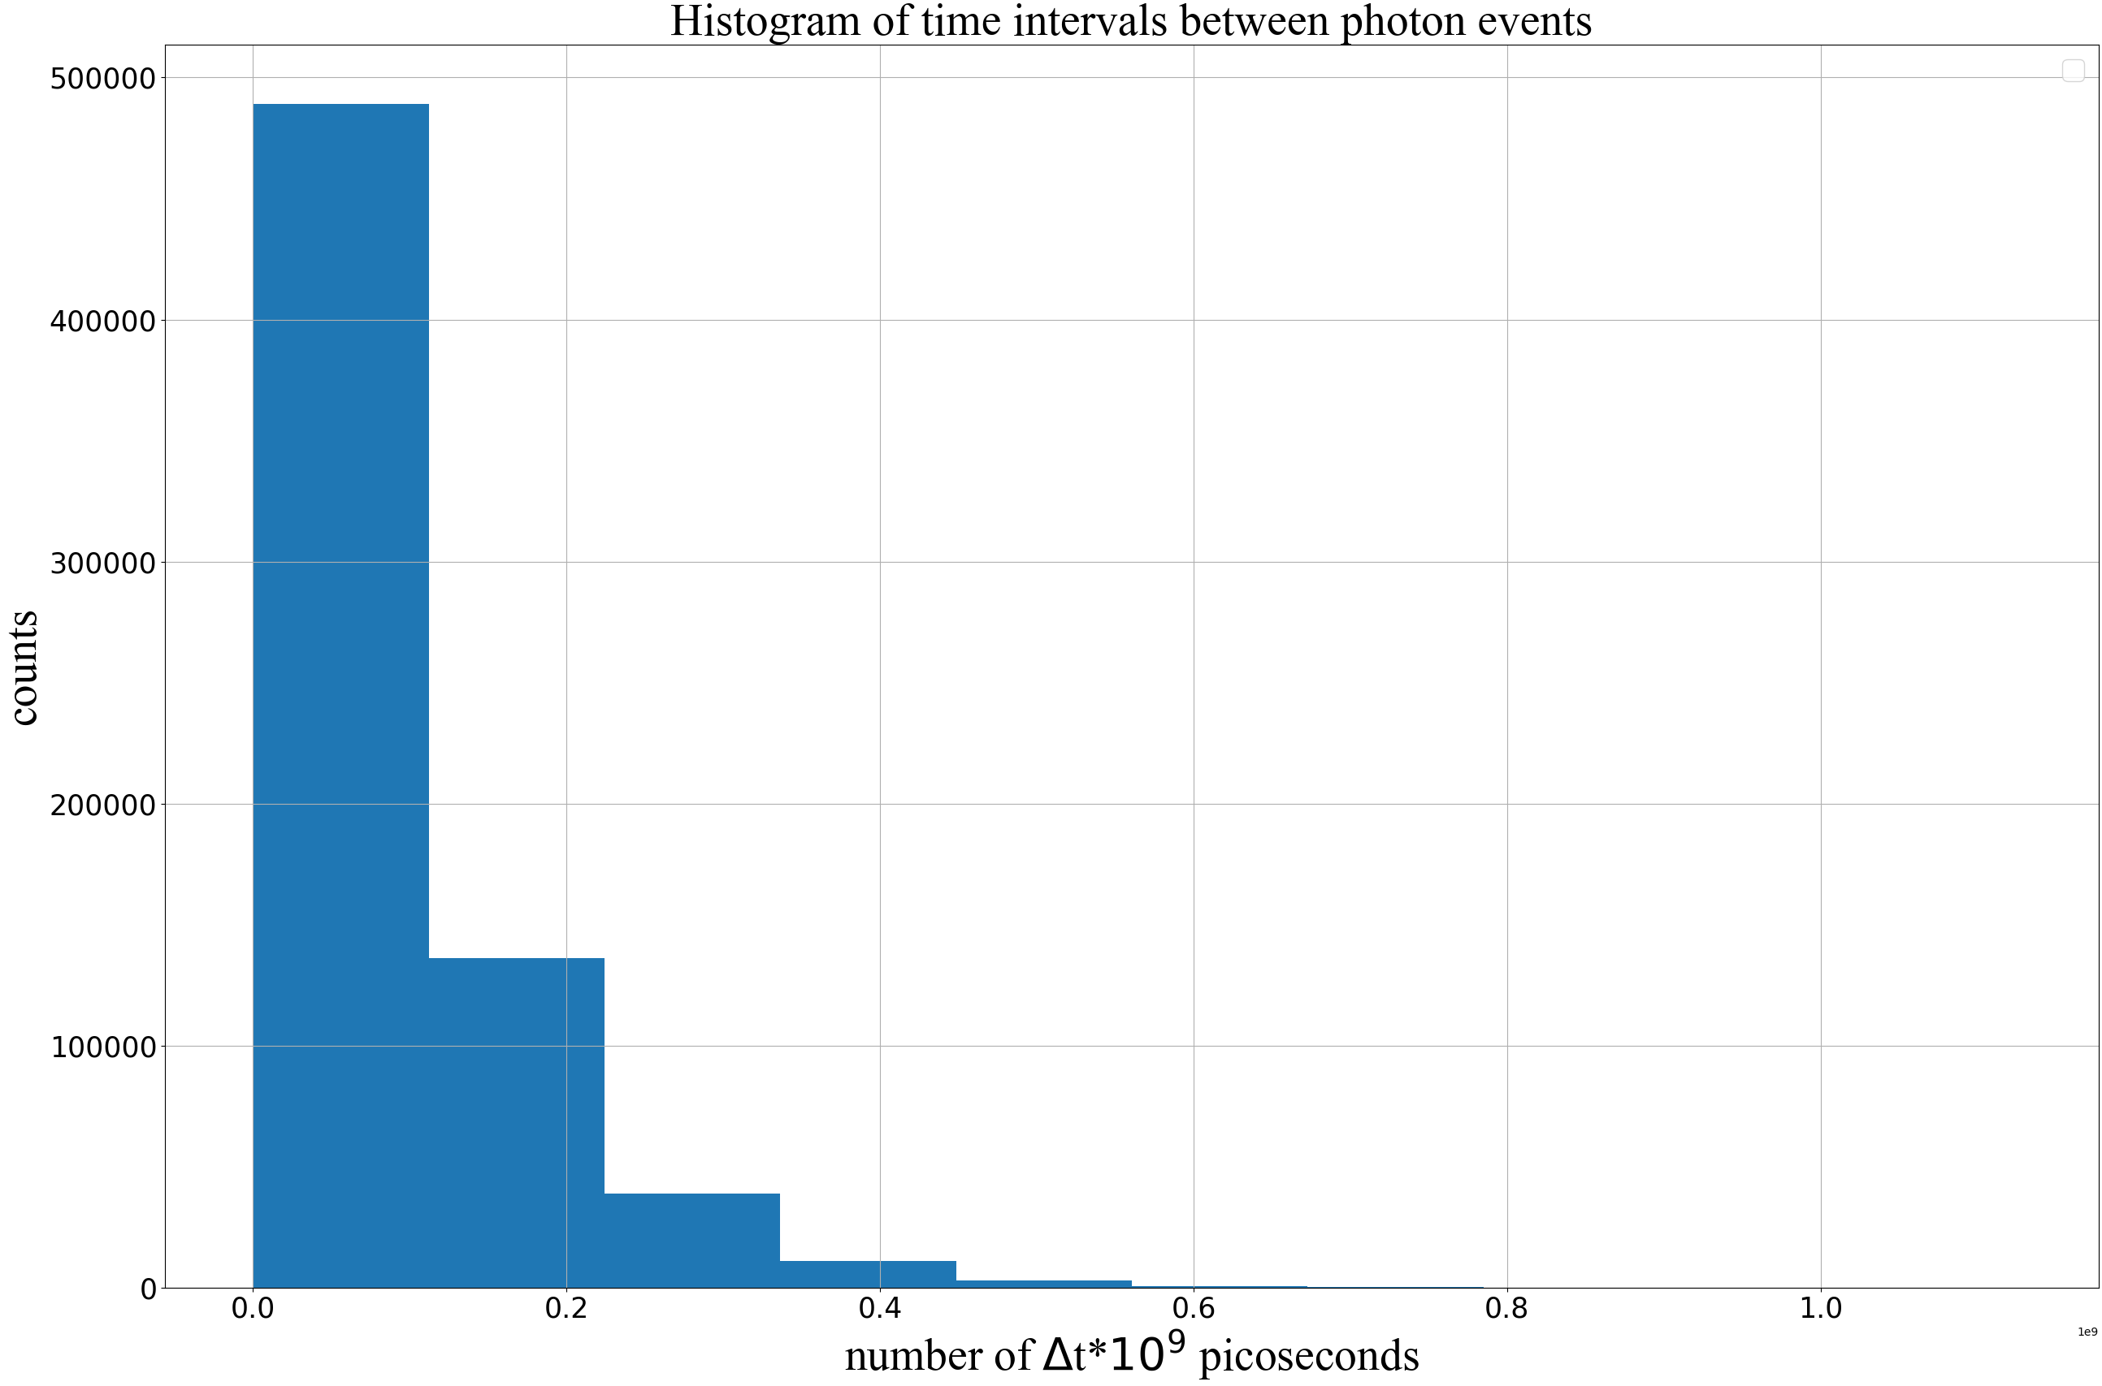
Antibunching photon data
Photon arrival time measurements provided by Picoquant

Slide 5
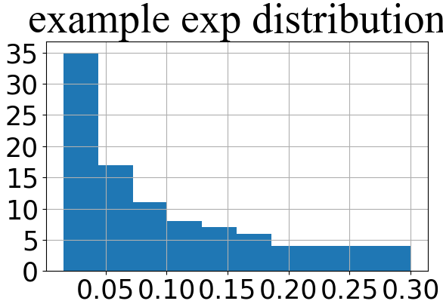
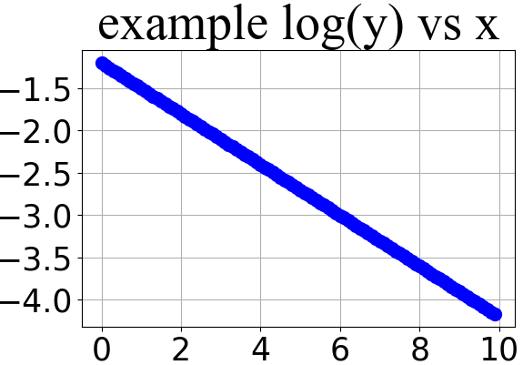
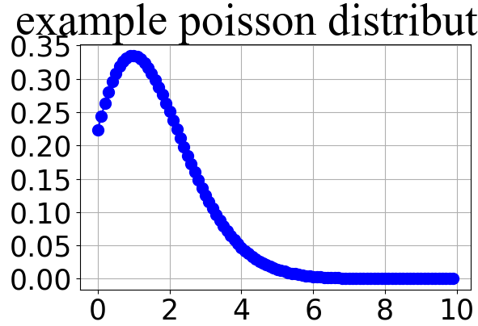

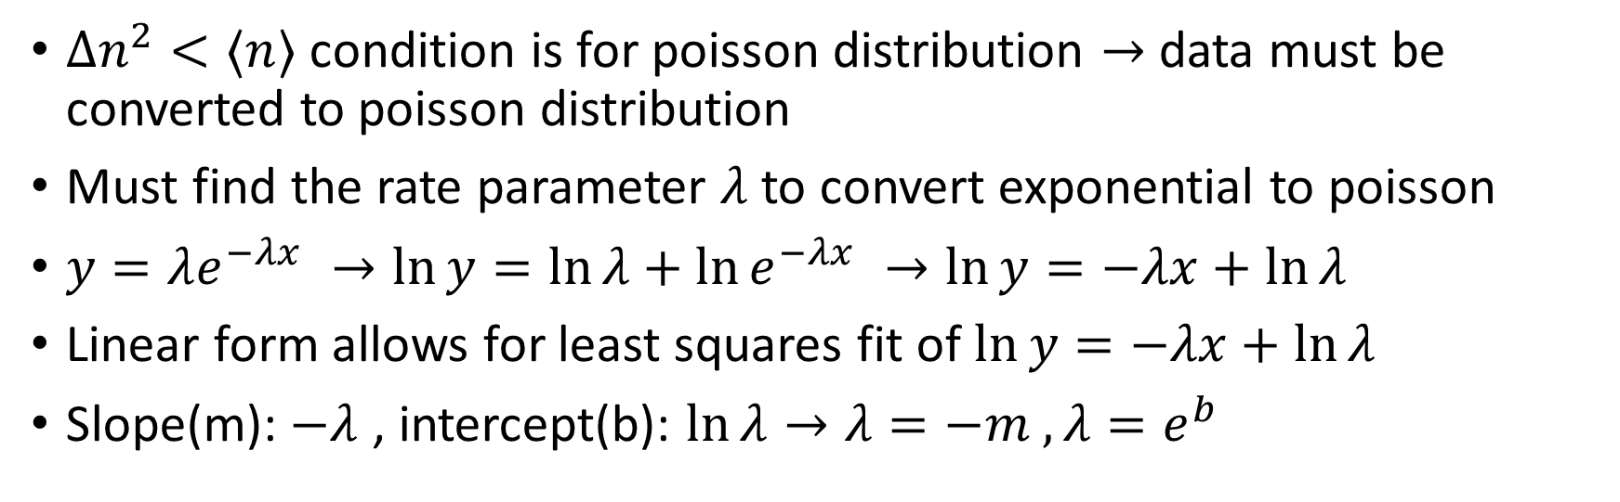




Linearizing exponential distribution
$Δn^{2}<⟨n⟩$ condition is for poisson distribution $→$ data must be converted to poisson distribution
Must find the rate parameter $λ$ to convert exponential to poisson
$y=λe^{−λx} →\ln{y=\ln{λ+\ln{e^{−λx} →\ln{y=−λx+\ln{λ}}}}}$
Linear form allows for least squares fit of $\ln{y=−λx+\ln{λ}}$
Slope(m): $−λ$ , intercept(b): $\ln{λ}→λ=−m , λ=e^{b}$
$$\ln{y=−λx+\ln{λ}}$$
$$−m=λ$$
$$→$$
$$→$$
$$e^{b}=λ$$

Slide 6
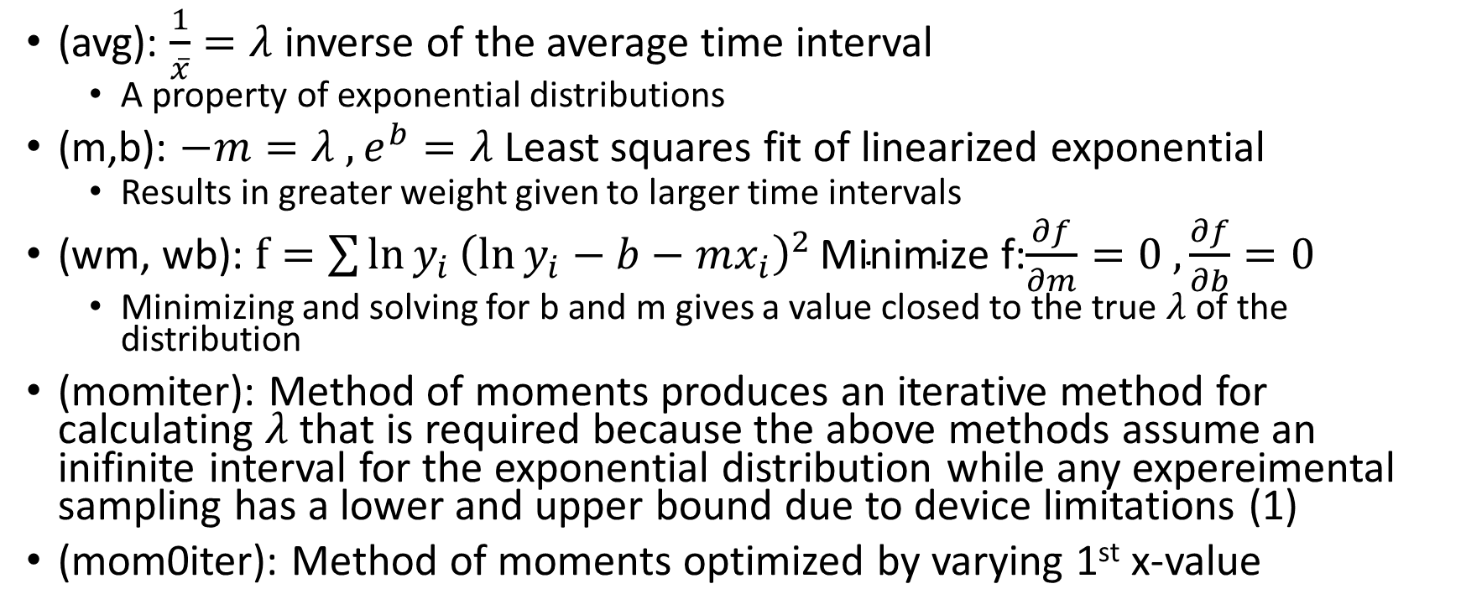

Methods of obtaining $λ$
(avg): $\frac{1}{\overline{x}}=λ$ inverse of the average time interval
A property of exponential distributions
(m,b): $−m=λ , e^{b}=λ$Least squares fit of linearized exponential
Results in greater weight given to larger time intervals
(wm, wb): $f=\sum{{\ln{y_{i}}\left(\ln{y_{i}}−b−mx_{i}\right)}^{2}}\text{Minimize}$ f:$\frac{∂f}{∂m}=0 ,\frac{∂f}{∂b}=0$
Minimizing and solving for b and m gives a value closed to the true $λ$of the distribution
(momiter): Method of moments produces an iterative method for calculating $λ$ that is required because the above methods assume an inifinite interval for the exponential distribution while any expereimental sampling has a lower and upper bound due to device limitations (1)
(mom0iter): Method of moments optimized by varying 1st x-value

Slide 7
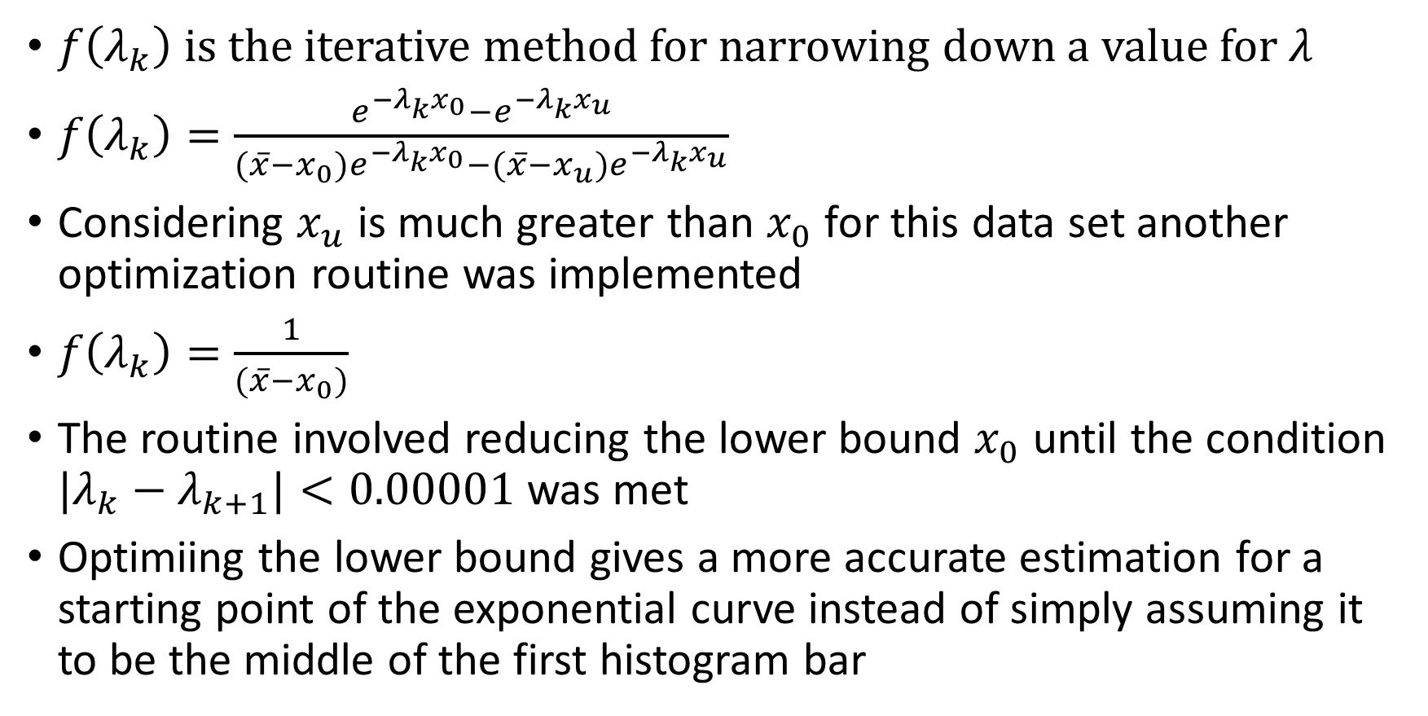
More on Method of Moments
$f\left(λ_{k}\right)$ is the iterative method for narrowing down a value for $λ$
$f\left(λ_{k}\right)=\frac{e^{−λ_{k}x_{0}}−e^{−λ_{k}x_{u}}}{{(\overline{x}−x_{0})e}^{−λ_{k}x_{0}}−(\overline{x}−x_{u})e^{−λ_{k}x_{u}}}$
Considering $x_{u}$ is much greater than $x_{0}$ for this data set another optimization routine was implemented
$f\left(λ_{k}\right)=\frac{1}{(\overline{x}−x_{0})}$
The routine involved reducing the lower bound $x_{0}$ until the condition ${|λ}_{k}−λ_{k+1}|<0.00001$ was met
Optimiing the lower bound gives a more accurate estimation for a starting point of the exponential curve instead of simply assuming it to be the middle of the first histogram bar

Slide 8
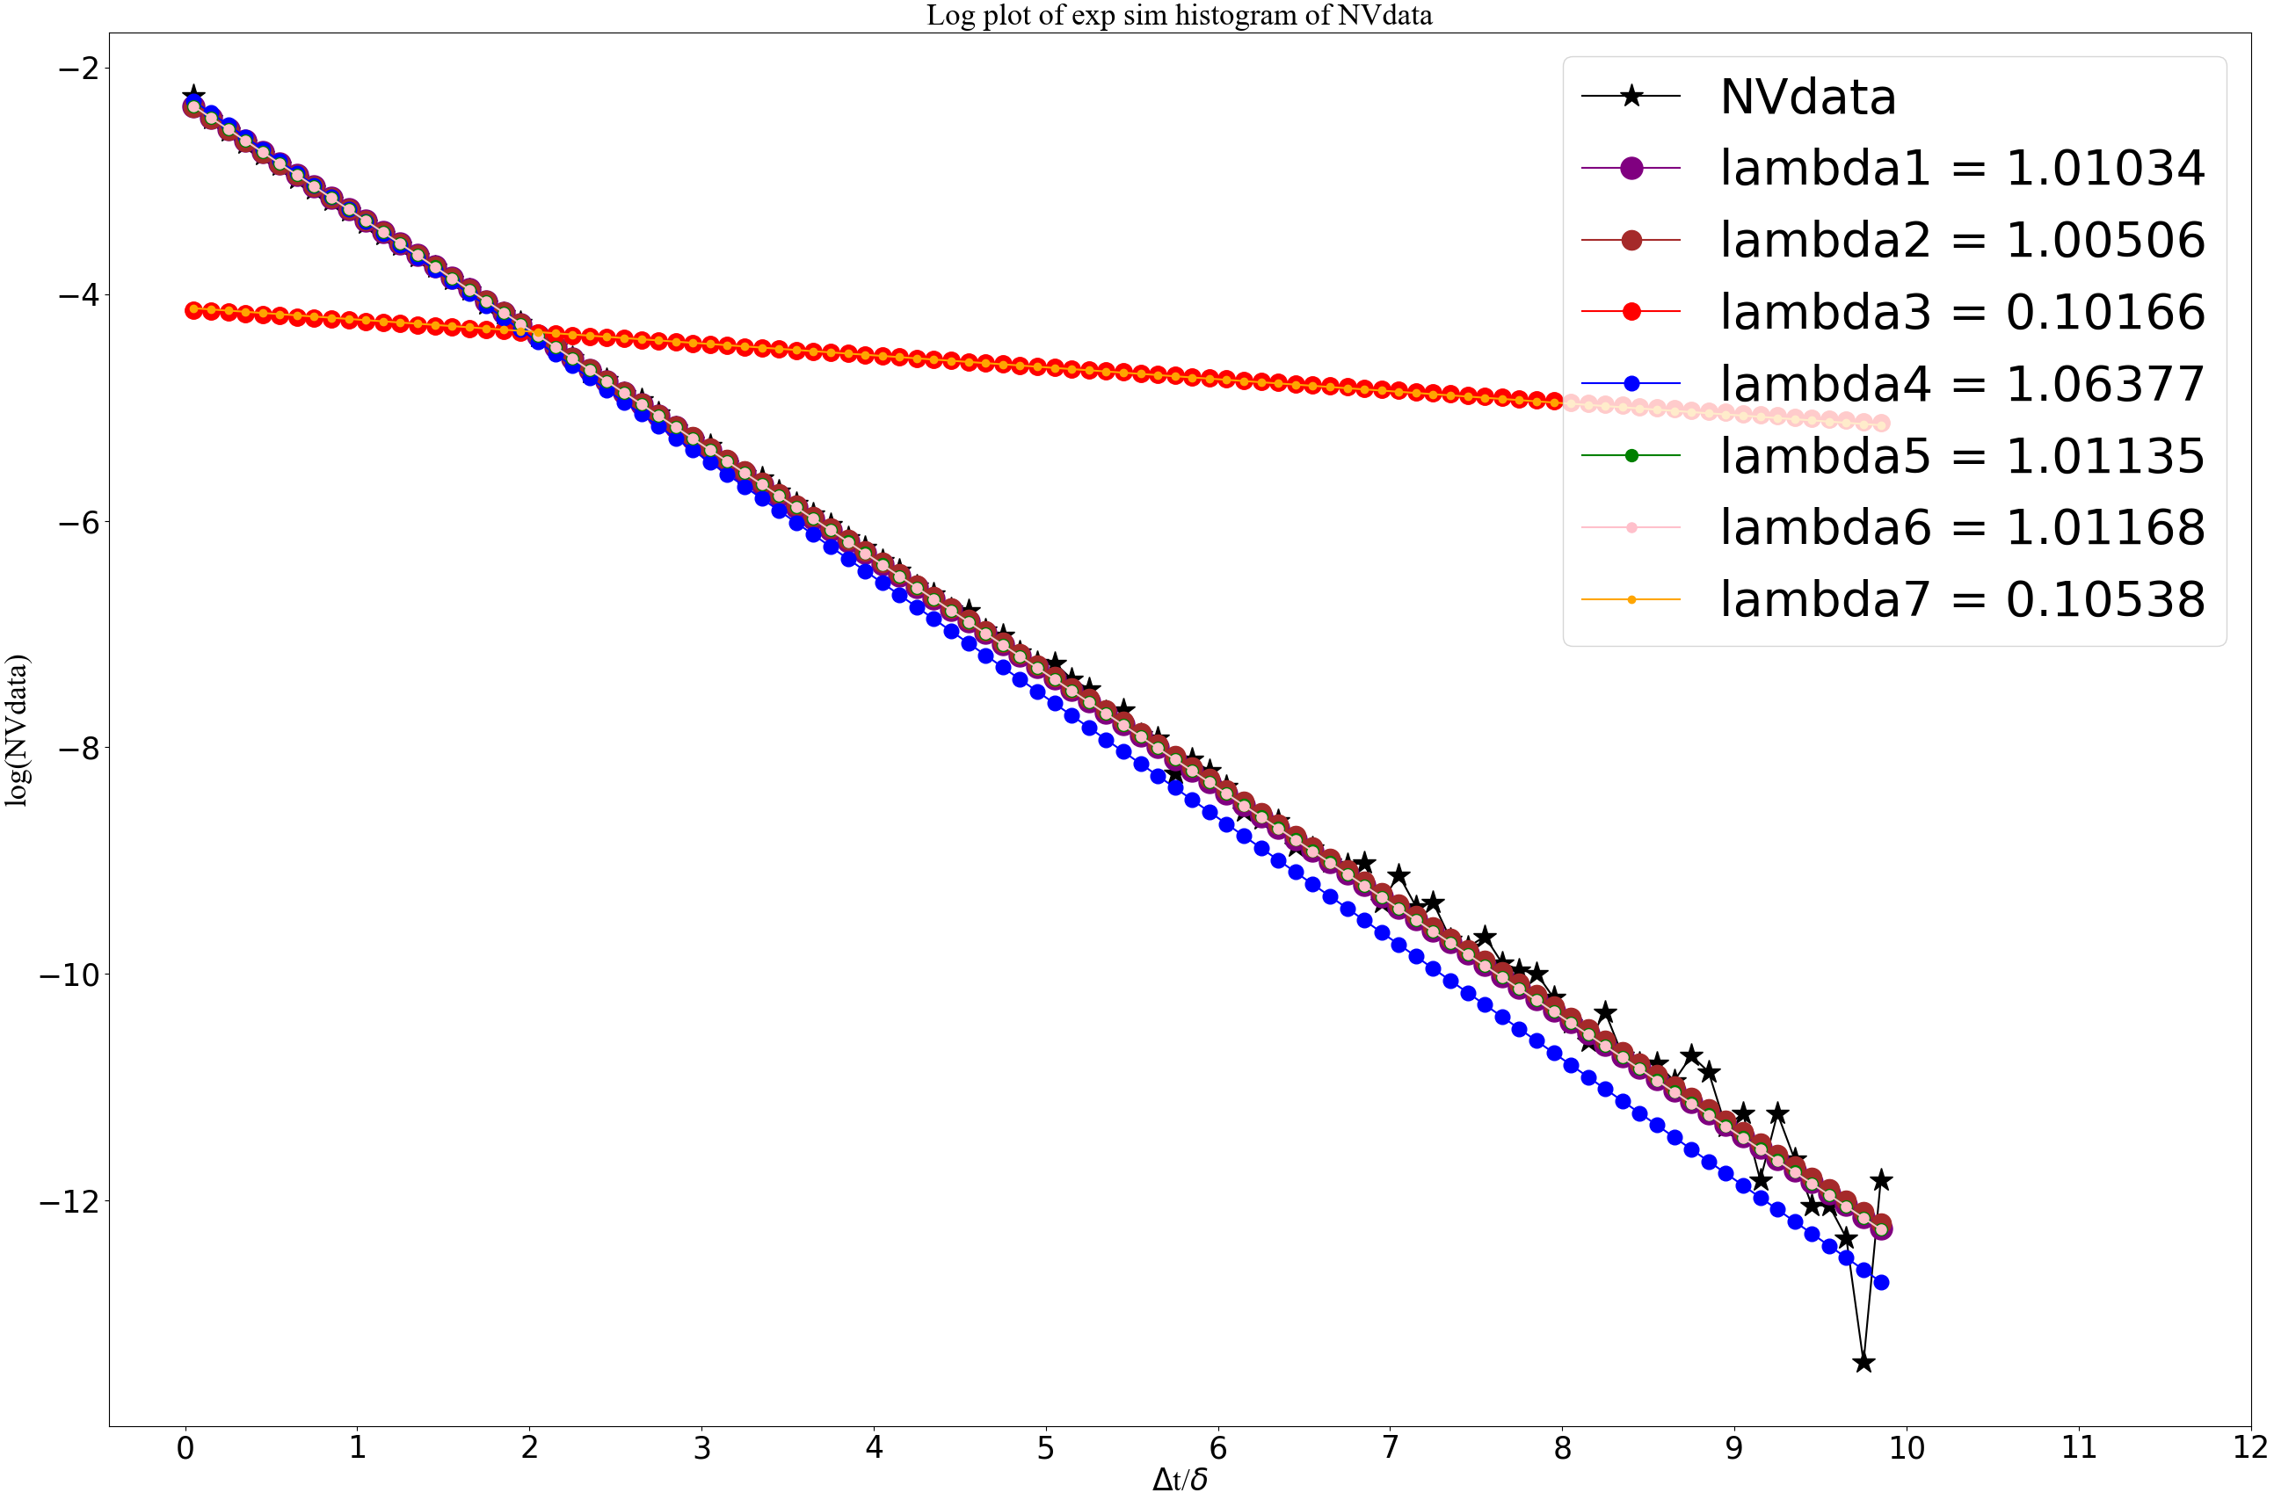
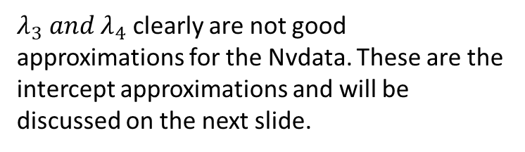
$λ_{3} and λ_{4}$ clearly are not good approximations for the Nvdata. These are the intercept approximations and will be discussed on the next slide.

Slide 9
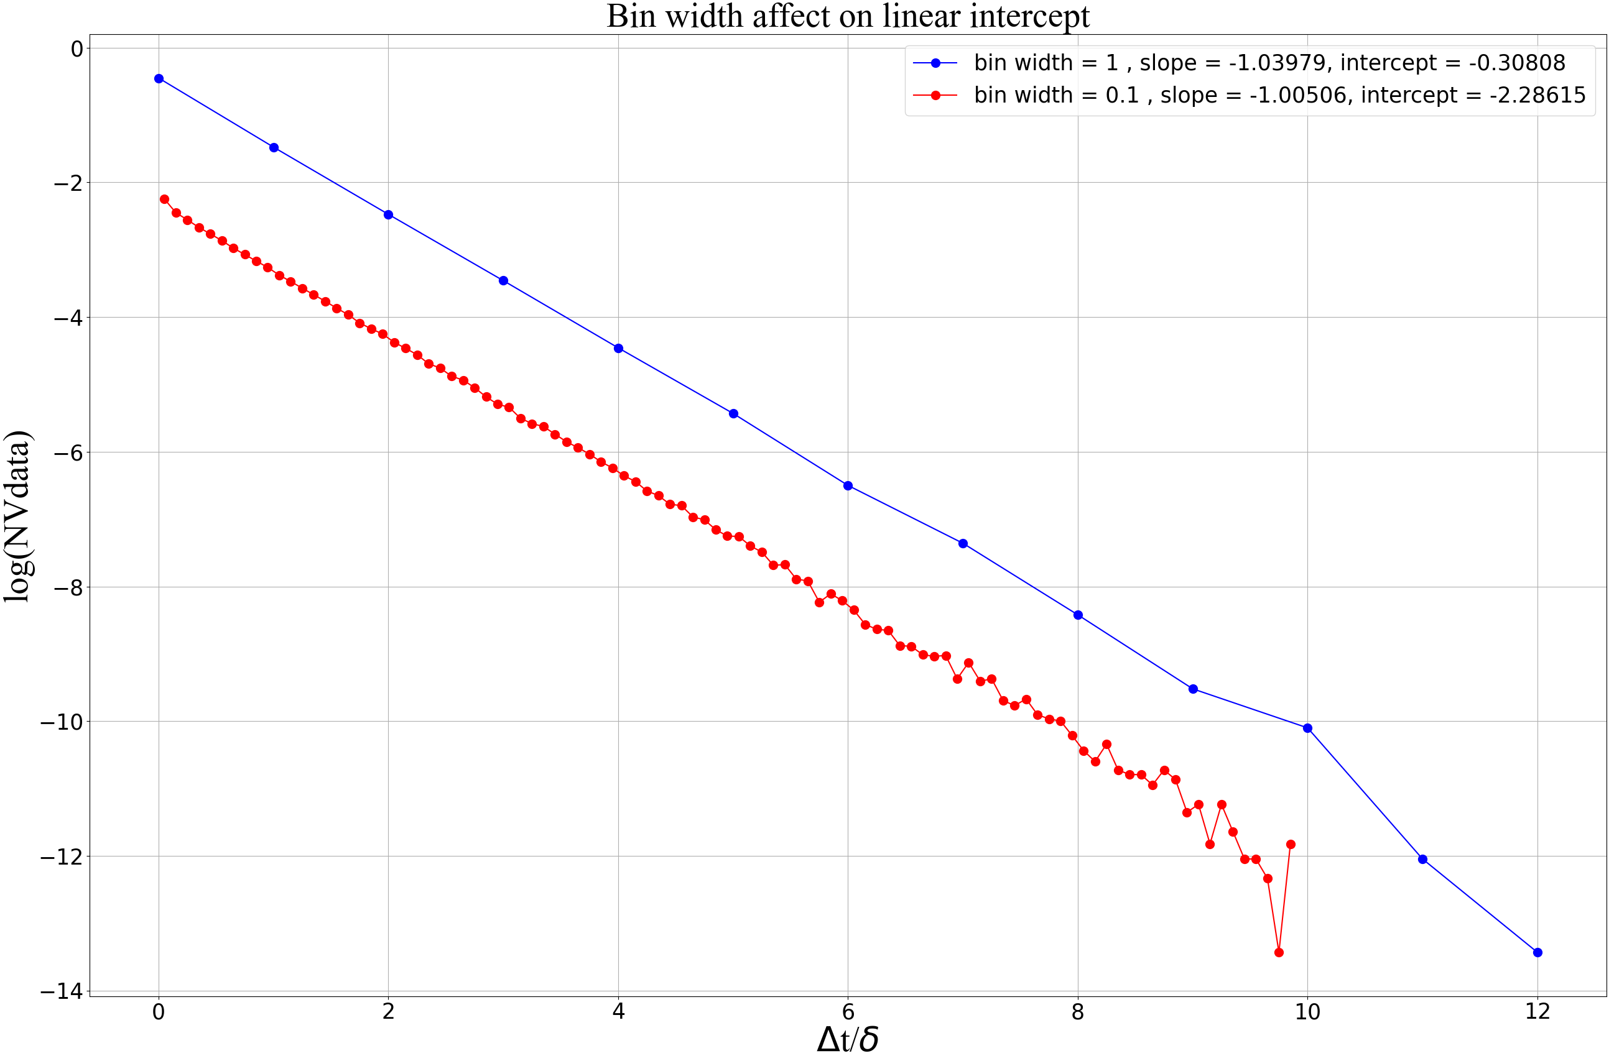
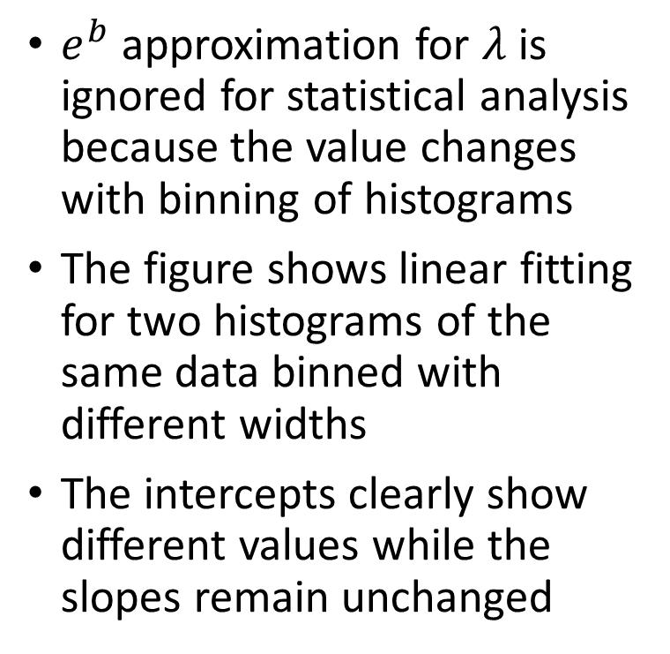

Issues with ${λ=e}^{b}$
$e^{b}$ approximation for $λ$ is ignored for statistical analysis because the value changes with binning of histograms
The figure shows linear fitting for two histograms of the same data binned with different widths
The intercepts clearly show different values while the slopes remain unchanged

Slide 10
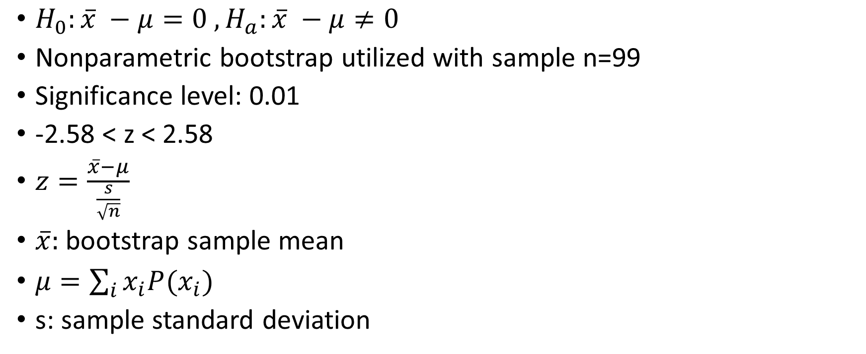
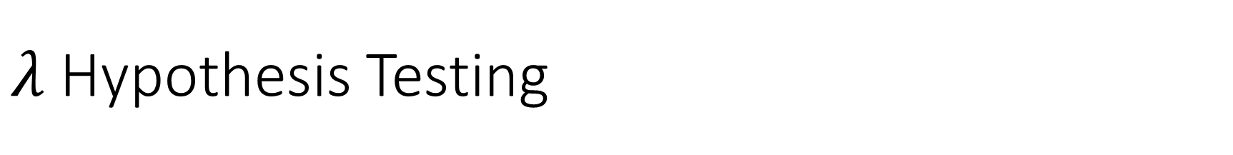
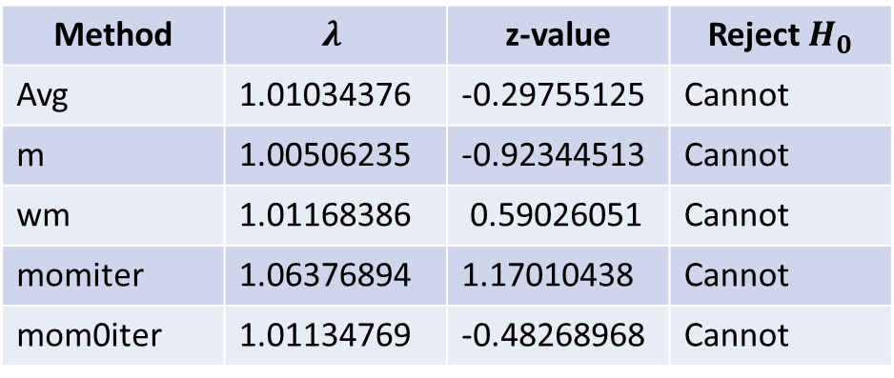
$λ$Hypothesis Testing
$H_{0}:\overline{x} −μ=0 , H_{a}:\overline{x} −μ≠0$
Nonparametric bootstrap utilized with sample n=99
Significance level: 0.01
-2.58 < z < 2.58
$z=\frac{\overline{x}−μ}{\frac{s}{\sqrt{n}}}$
$\overline{x}:$ bootstrap sample mean
$μ=\sum_{i}{x_{i}P(x_{i})}$
s: sample standard deviation
Method | $$λ$$ | z-value | Reject $H_{0}$
Avg | 1.01034376 | -0.29755125 | Cannot
m | 1.00506235 | -0.92344513 | Cannot
wm | 1.01168386 | 0.59026051 | Cannot
momiter | 1.06376894 | 1.17010438 | Cannot
mom0iter | 1.01134769 | -0.48268968 | Cannot

Slide 11
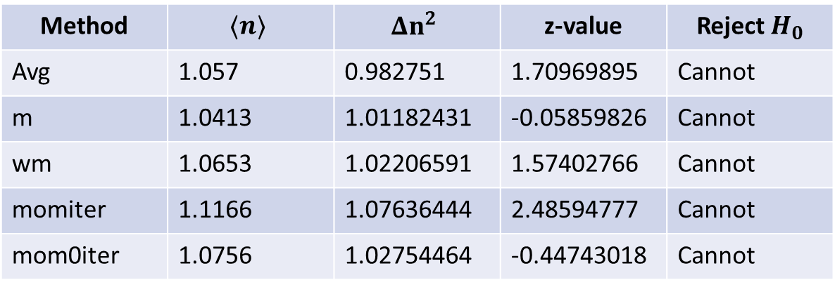
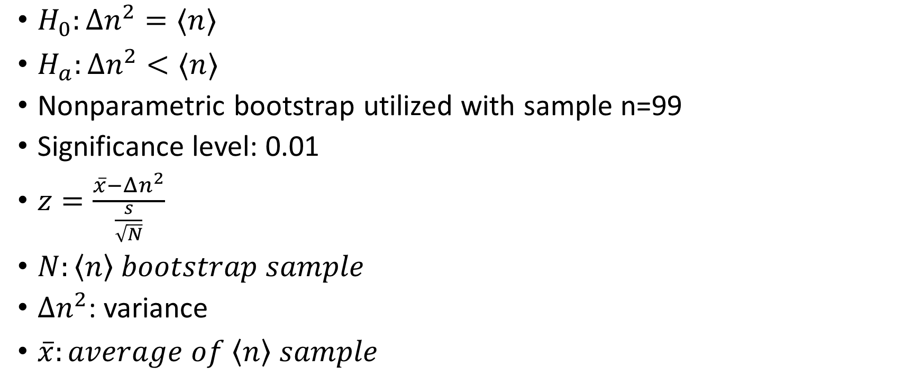
Sub-Poisson Hypothesis Test
$H_{0}:Δn^{2}=⟨n⟩$
$H_{a}:Δn^{2}<⟨n⟩$
Nonparametric bootstrap utilized with sample n=99
Significance level: 0.01
$z=\frac{\overline{x}−Δn^{2}}{\frac{s}{\sqrt{N}}}$
$N:\left\langle n\right\rangle bootstrap sample$
$Δn^{2}$: variance
$\overline{x}:average of \left\langle n\right\rangle sample$
Method | $$⟨n⟩$$ | $$Δn^{2}$$ | z-value | Reject $H_{0}$
Avg | 1.057 | 0.982751 | 1.70969895 | Cannot
m | 1.0413 | 1.01182431 | -0.05859826 | Cannot
wm | 1.0653 | 1.02206591 | 1.57402766 | Cannot
momiter | 1.1166 | 1.07636444 | 2.48594777 | Cannot
mom0iter | 1.0756 | 1.02754464 | -0.44743018 | Cannot

Slide 12
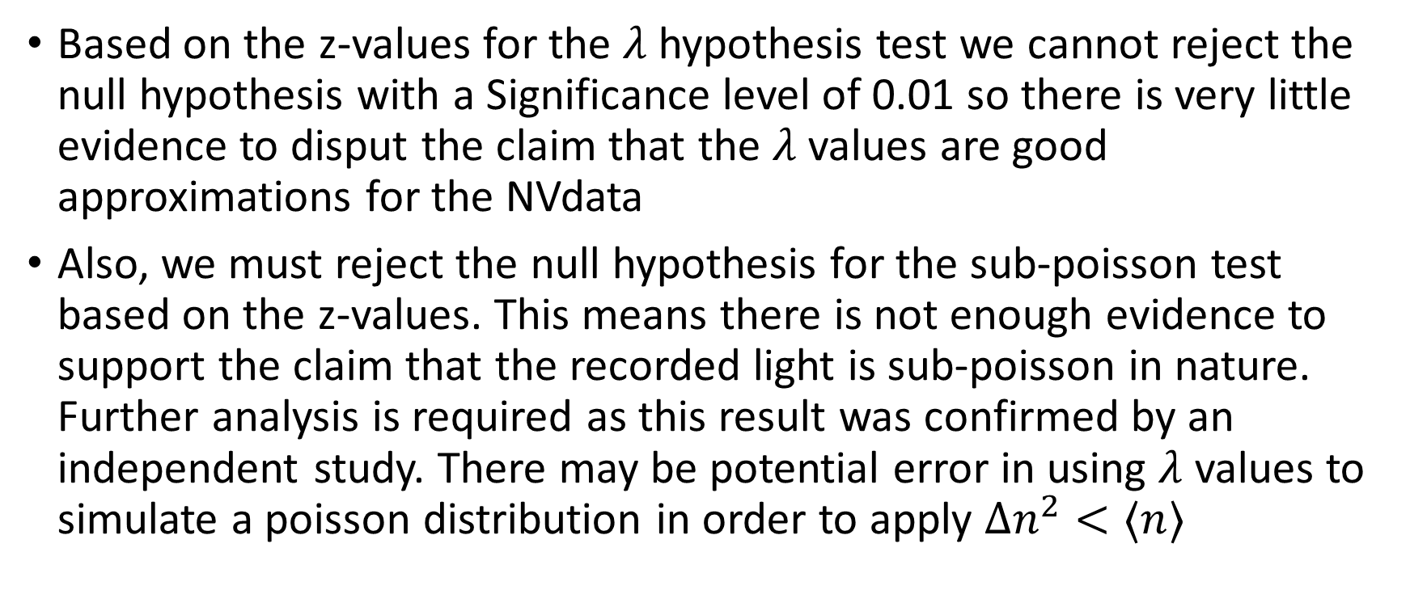
Conclusion
Based on the z-values for the $λ$ hypothesis test we cannot reject the null hypothesis with a Significance level of 0.01 so there is very little evidence to disput the claim that the $λ$ values are good approximations for the NVdata
Also, we must reject the null hypothesis for the sub-poisson test based on the z-values. This means there is not enough evidence to support the claim that the recorded light is sub-poisson in nature. Further analysis is required as this result was confirmed by an independent study. There may be potential error in using $λ$ values to simulate a poisson distribution in order to apply $Δn^{2}<⟨n⟩$

Slide 13
Reference
(1): Fitting an Exponential Distribution: Roberto Fraile and Eduardo Garcia-Ortega

